Slide 1
Market Place - MVP AWS Serverless Architecture

Slide 2

















Amazon Route 53
Amazon SQS
AWS Lambda
Atlas MongoDB
MP Clients
Data
Apigee API Gateway
Amazon CloudFront
(CDN)
Amazon API Gateway
AWS Lambda
Amazon SNS
Amazon CloudWatch
Monitoring & Analytics
IAM
Messaging/Workflow
Security
Atlas MongoDB
Cloud Formation
CI/CD
Market Place
7Now
Meta Data (Catalog, Store details, Delivery Providers, settlement file)
Ec2 – Batch Server

Slide 3
List of Microservices

Slide 4
MP Store Setup Services (Meta Data)
REST
Catalog Services (Batch & Live)
MP Atlas MongoDB
UserProfile Services
Order Management Services
MP Clients
7Now AWS Lambda
Tax Services
One Source
Payment Services
Market Place
Setup Services : Location Info

Slide 5
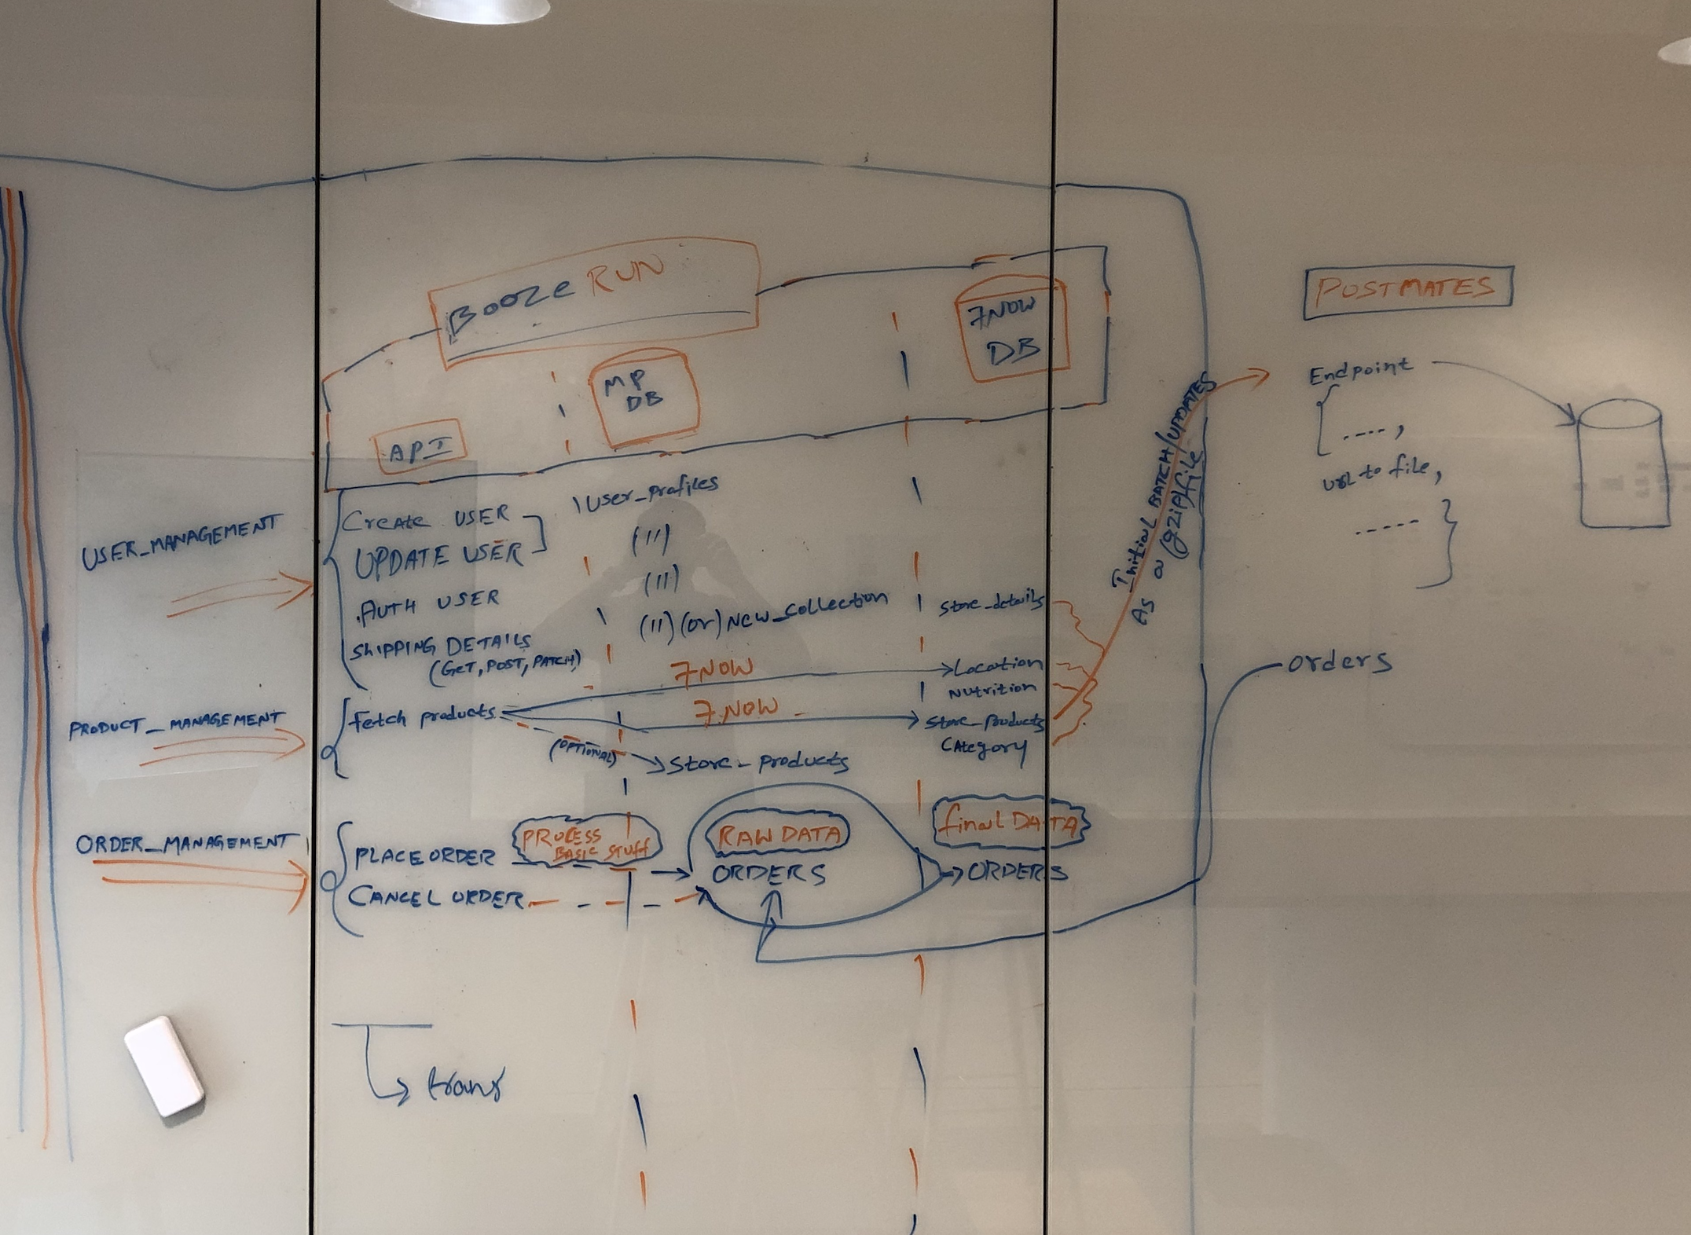

Slide 6
List of Collections in Databases

Slide 7
User Management Orders Raw Data + status Job Sync Status
Inventory
Store Details
Orders Payments
Store Details
Store Products
Market Place
7Now

Slide 8
Questions :
General :
Cancellation of Orders by 7-Eleven Store
Modifiers need to be included with products
Bundles & Vendor funded Promos has to be handled, basket fee
Handling payments
Do we need do age verification for alcohol products
Who does Tax calculations
Technical :
Catalog refresh set up

Slide 9
Google Integration :

Slide 10
Food Ordering
Inventory Feeds
Fulfillment Actions
Restaurant entity
Service entity
Menu entity
Checkout Action
SubmitOrder Action

